Slide 1
C# 8.0
Preview 5

Slide 2
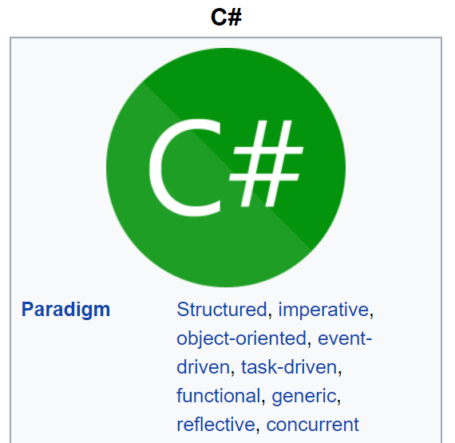
Multiparadigm

Slide 3
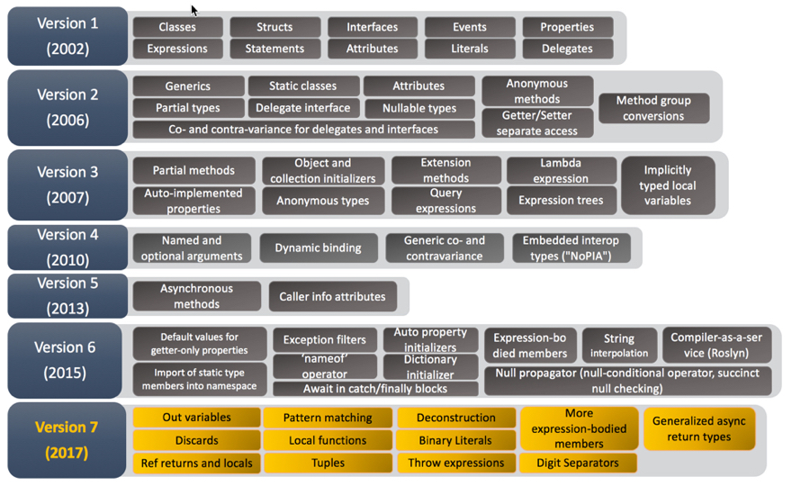
Evolution of C#

Slide 4
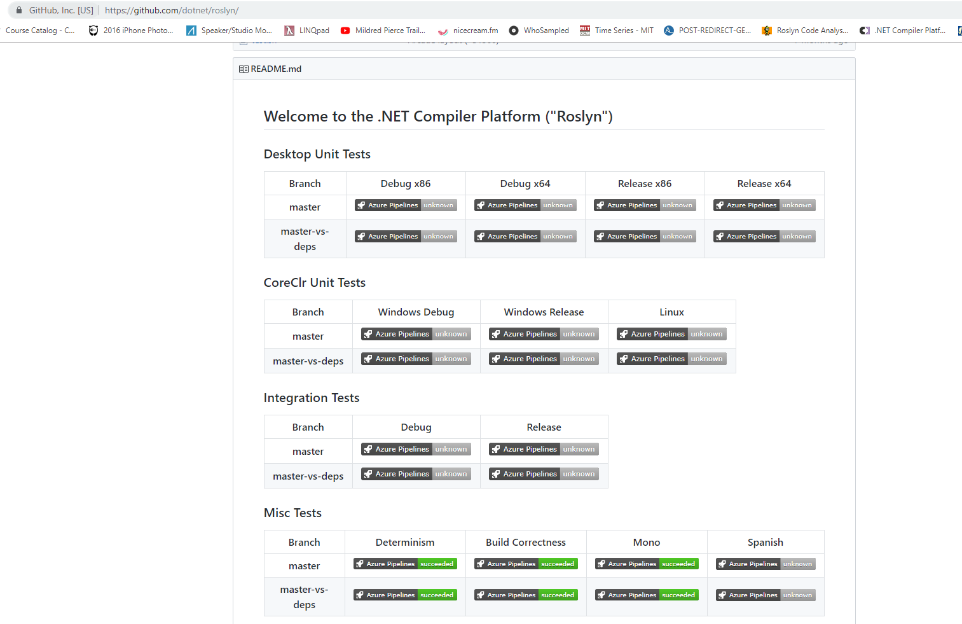
Roslyn (Compiler as a Service)

Slide 5

Csharplang

Slide 6

??

Slide 7

Shipping of VS2019, .NET Core 3.0 & C# 8.0

Slide 8
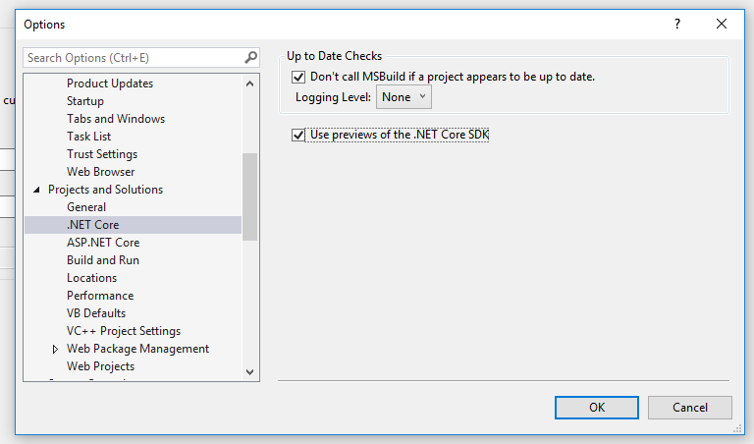
Enabling C# 8.0 in your VS2019

Slide 9
Tuples & Pattern Matching
In mathematics, a tuple is a finite ordered list (sequence) of elements […] for example, (2, 7, 4, 1, 7) [https://en.wikipedia.org/wiki/Tuple]
In computer science, pattern matching is the act of checking a given sequence of tokens for the presence of the constituents of some pattern [https://en.wikipedia.org/wiki/Pattern_matching]

Slide 10
Tuples & Pattern matching in C# 7.0

Slide 11
Tuples & Pattern matching in C# 8.0
Switch expressions
Positional Patterns
Property Patterns
Type patterns
Default pattern
Tuple Patterns

Slide 12
Ranges & Indices

Slide 13
Readonly members
Demo

Slide 14
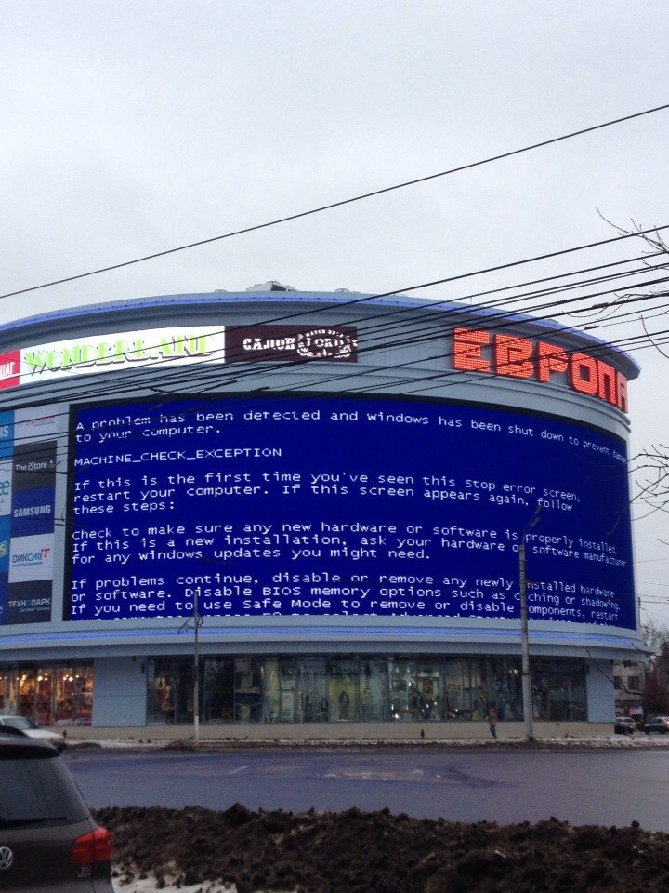
Nullable Reference Types (1)

Slide 15
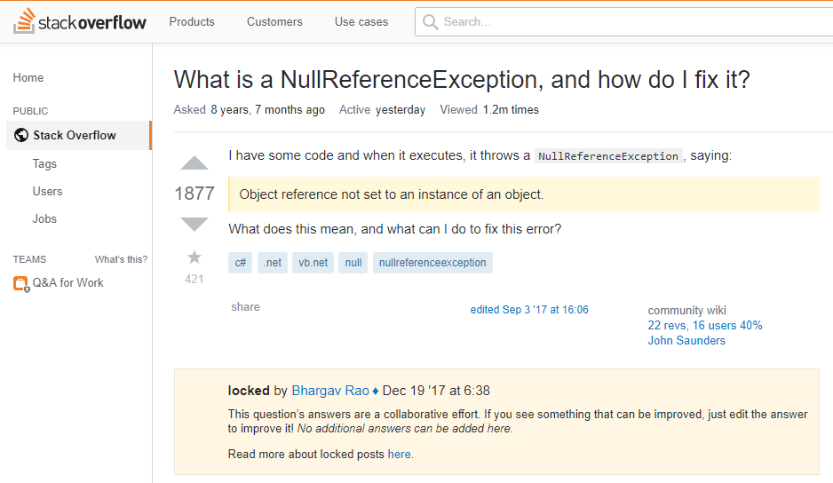
Never seen it before

Slide 16
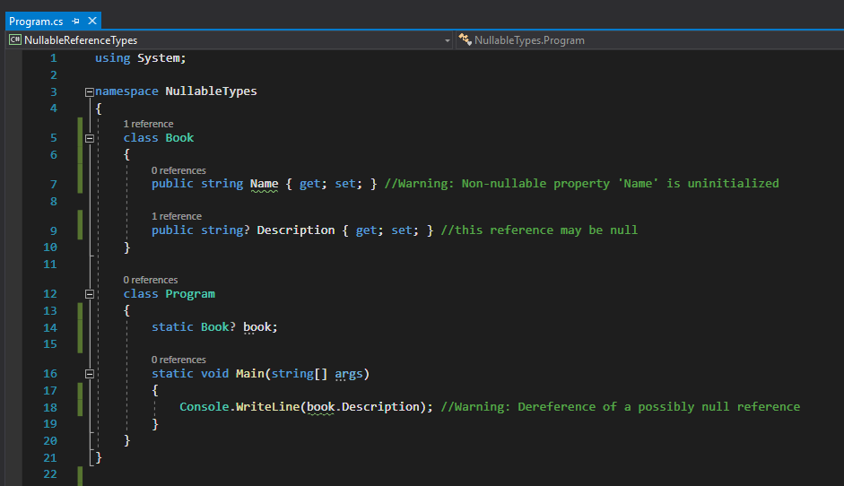
(Explicitly) Nullable Reference Types (2)
Aren’t all reference types nullable already?
They are indeed.

Slide 17
Nullable Reference Types (3)
Breaking Change?
Book book; has a different meaning between C# 7.0 and 8.0
Well, not really
The feature is Opt-in
It only gives warnings
IL is fully compatible between C# 7 & 8

Slide 18
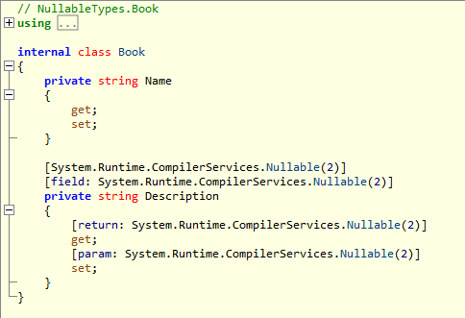
Nullable Reference Types (4)
What does the compiler actually translate “string? Str” into?
Nullable<int> vs [Nullable] string
This is why it not breaking change

Slide 19
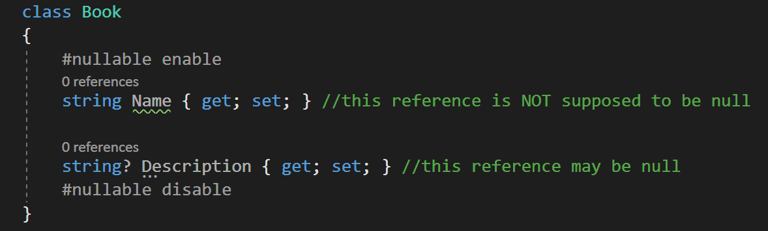
Enabling nullable context
Project wide: <NullableContextOptions>enable</NullableContextOptions>
In code:

Slide 20
Demo
Usage example
The null-forgiving operator

Slide 21
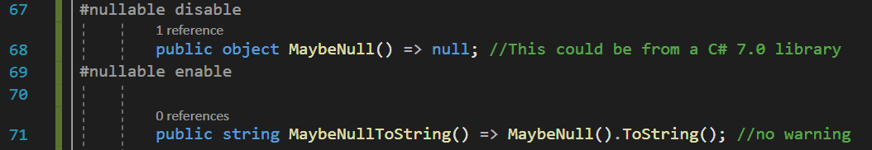
Oblivious State

Slide 22
Project Settings
Nullable annotation context options:
Enable: Can you use ? Operator to declare a type explicitly nullable
Disable: C# 7.0
Nullable warning context options
Disable: no warnings at all
SafeOnly: Only warn if a null reference exception might happen
Enable: Also warn mismatches of nullable and non-nullable types

Slide 23
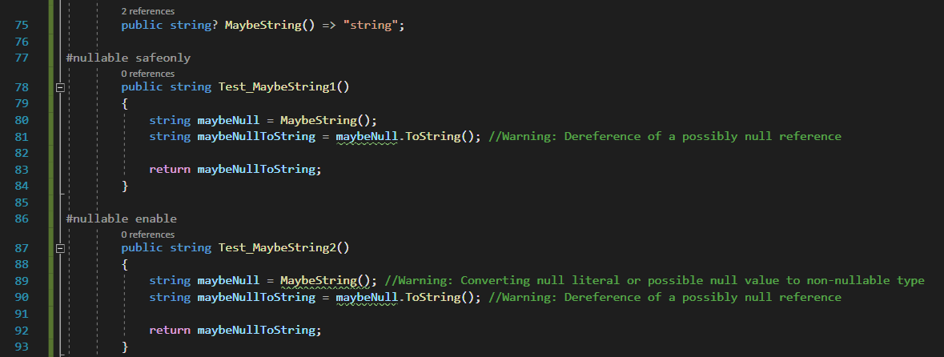
SafeOnly vs Enabled

Slide 24
Project settings - .csproj
<NullableContextOptions>enable</NullableContextOptions>
Disable
Nullable annotation context and warning context are disabled
Enable
Nullable annotation context and warning context are enabled
SafeOnly
Nullable annotation context is enabled and warning context is safeonly
Warnings
Nullable annotation context is disabled and warning context is enabled
SafeOnlyWarnings
Nullable annotation context is disabled and warning context is safeonly

Slide 25
Thoughts?
Place your bets
We will find out in a couple of years who won

Slide 26
Using declarations
Not much to say

Slide 27
Static Local Functions
Again not much to say

Slide 28
Async Streams
Demo

Slide 29
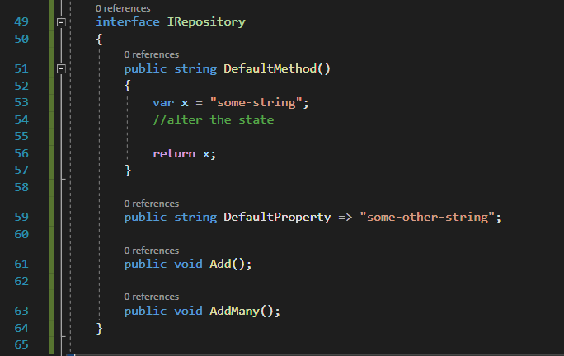
Default Interface Members

